Slide 1
Adult Safeguarding Forum: Reflections of an Interim GP
Dr Faiza Mehdi
South-East London CCG (Southwark)
May 2021

Slide 2
Reflections of an Interim GP
Personal reflection
Learning from DHRs and SARs
Documentation
What is most effective way of sharing safeguarding learning?
What are the barriers to implementation?

Slide 3
Documentation and Safeguarding
Healthcare is an MDT process and good patient records allow effective communication between health professions
Continuity of care – record should allow another practitioner to reconstruct and effectively continue care for patient
Patients or their relatives may read the notes
“Assume that any entries made in a patient or client record will be scrutinised at some point”
Taken from Bond Solon Training: ‘Clinical Leadership in Safeguarding’ March 2021

Slide 4
Documentation
The following four slides are taken from Bond Solon training course: Clinical Leadership in Safeguarding (March 2021)
Verbal consent given during course to share material

Slide 5
Best Practice in notes and record keeping
Notes and Records must include
Date
Time
Place
People Present
All key times recorded [Time and duration of breaks]
Other facts relevant to context. Any non-verbal communications?
All relevant facts
No assumptions
Chronological order
Taken from Bond Solon Training: ‘Clinical Leadership in Safeguarding’ March 2021

Slide 6
Best Practice in notes and record keeping
Notes and records must include
No erasures
No leaves torn out
Blank spaces ruled out
No overwriting
Crossings out initialled by maker/interviewee
No writing in margins
Clear reference to exhibits/documents/objects
Exhibits labelled
Recorded all questions/comments/answers
Recorded time that notes began and ended
Taken from Bond Solon Training: ‘Clinical Leadership in Safeguarding’ March 2021

Slide 7
Best Practice in notes and record keeping
Notes and records must include
Recorded where notes made
Checked for mistakes
Correct grammatical English
Clear plain language
Description of exhibits, number of exhibits, person producing it, where it was found, where originated, whether copied, where exhibits being secured.
Avoided using abbreviations
Avoided approximations
Did not miss out key words
Did not use arrows/dashes
Notes capable of acting as contemporaneous notes to refresh memory
Identity of author of notes
Taken from Bond Solon Training: ‘Clinical Leadership in Safeguarding’ March 2021

Slide 8
Facts, Assumptions or Opinions
Fact or assumption ?
In the event that evidence is needed for claims, complaints or other legal proceedings, it is vital that the Healthcare Professional/organisation has accurate records. It is also vital that these records record facts and avoid unaccounted for speculation or assumptions.
Healthcare Professionals must record facts and the source of facts, and should not make assumptions or draw inferences without the facts.
Fact
A fact is what has been seen, heard or done by the writer. Such facts should be recorded contemporaneously if possible.
An Assumption/inference
A statement about the unknown based on the known. It is vital for Healthcare Professionals to seek and record facts, and not to make assumptions and inferences unless they are based on facts.
An opinion
The Health Professional will form an opinion based on a fact.
Taken from Bond Solon Training: ‘Clinical Leadership in Safeguarding’ March 2021

Slide 9
Mental Health
n=2 DHRs, n = 2 SARs
Issues around how it is managed – processes
Thornicroft (2020) in The Lancet: people with mental illness are more likely to be victims of violence than perpetrators. Rates of perpetrating violence slightly higher in Schizophrenia and bipolar disorder. Triple morbidity – severe mental illness + substance misuse + antisocial PD – substantially more likely to be violent

Slide 10
Common Themes
Victim | Perpetrator
Minimal contacts | Many contacts
Often only GP and A&E attendances | Multiple agencies involved
No documentation of ever being asked about domestic abuse | Mental health problems in young men recognized but no robust management plan in place
Minimal documentation of social circumstances, including relationships, in GP notes | Minimal documentation of (often very difficult) social circumstances, including relationships, in GP notes

Slide 11
Domestic Abuse: Routine & Targeted/ Clinical Enquiry
Routine enquiry: all service users asked about experience of domestic abuse, regardless of any signs/suspicions of abuse
Targeted/Clinical enquiry: low threshold for asking service users about experience of domestic abuse when they present with certain indicators of abuse
From ‘Ask and Take Action: Why public services must ask about domestic abuse’ August 2019

Slide 12
IRIS Training Tips
Ask
For those living with others during lockdown, consider using yes/no questions. Further guidance is available in the folder.
➢ Are you having any problems with your husband/partner/anyone at home? Has someone hurt you?
➢ Some women have these symptoms when they are at risk of abuse. Are you afraid of anyone at home? Does anyone try to control you or what you do?
➢ Sometimes women who have these symptoms/injuries have been frightened or hurt by someone at home. Has anyone’s behaviour upset you?
➢ Are there things that happen at home that scare you? Are you afraid of anyone at home?
➢ Sometimes people with depression/low self-esteem have experienced major life events that cause this and can explain why they feel so low. Living in an abusive relationship can cause this. Might that be happening to you?
Respond
➢I believe you. ➢It’s not your fault. ➢Support is available. ➢Thank you for telling me ➢Everyone has the right to be safe at home
Risk Check
➢Is it safe to go/stay at home? ➢What are you afraid might happen? ➢What has the abuser threatened? ➢What about threats to the children?
Please refer to relevant IRIS referral pathway when responding to disclosures of domestic abuse.

Slide 13
Domestic Abuse: Documentation & Coding
Code ‘History of Domestic Abuse’ as major active problem
Document name and relationship of anyone accompanying patient to appointment
Name of alleged perpetrator should be documented when DA disclosed
Ensure reference to DA on victims record not accidentally visible to anyone else :
during consultation
print-outs
online access
Link EMRs of household/family
RCGP Guidance on recording domestic abuse in the electronic medical record

Slide 14
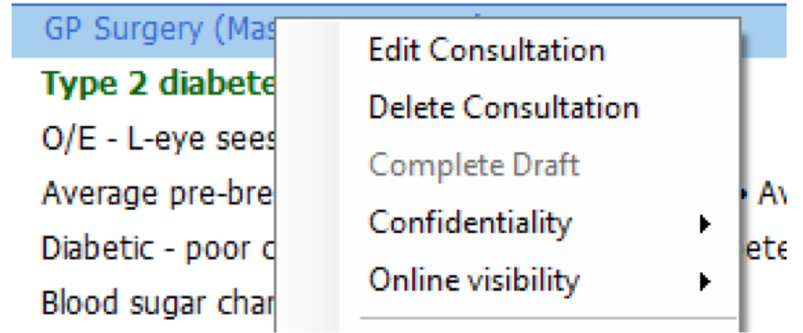
Online Visibility

Slide 15
Coding
Pattern recognition
Problem list: dynamic, clear

Slide 16
Mental Health: Enquiry & Documentation
Quality of interpersonal relationships
Living conditions and social isolation
History of domestic or sexual abuse
Employment and immigration status
Availability of social support
Alcohol and substance misuse
Taken from NICE Clinical Knowledge Summaries: Depression

Slide 17
Mental Health: Enquiry & Documentation
Risk factors that increase the risk of suicide:
Male
Lives alone
Unemployed
Drug/alcohol dependence
High risk groups:
Young & middle-aged men
In contact with criminal justice system
Risk to self & others
Taken from NICE Clinical Knowledge Summaries: Depression

Slide 18
Diversity & Inclusion
Which factors need to be considered
What can be done to reduce inequalities?
e.g. young, male, BAME, autistic with MH problems - consider making IAPT referral for him?

Slide 19
General Themes
Continuity of care
Follow-up
Tackle substance misuse early
MDT communication
Capacity
Social Prescribers
Think Family

Slide 20
Questions & Comments

